Slide 1
※ 디자인 변경이 안되는 부분은 [보기]- [슬라이드 마스터]에 들어가면 편집 가능합니다.
※ 슬라이드 좌우에 있는 샘플을 서식복사 , 복사, 컬러 스포이드 해서 사용하면 작업이 편합니다.
COLOR
작은 글자: KoPubWorld돋움체 Light 14pt
본문: KoPubWorld돋움체 Medium 18pt
제목: KoPubWorld돋움체 Bold 24pt
FONT COLOR
제목: KoPubWorld돋움체 Bold 32pt
Review : Progressive Layered Extraction(PLE)
A Novel Multi-Task Learning (MTL) Model for Personalized Recommendations
Kaist GSDS Master’s Degree
20224314
Hyeongu Kang

Slide 2
CONTENTS
1. Summary of Paper
2. Pros & Cons [opinion]
3. Research Idea
Define problem
Related work / prior method
Solving method
Experiment
Result
Base on 5 criteria

Slide 3
1. Summary of paper
Define Problem
Related work / prior method
Solving Method
Experiment
Result

Slide 4
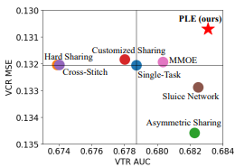
Define Problem
1. Summary
Problem of MTL : performance degeneration / Sacrifice each other
1) Negative Transfer
Common phenomenon in MTL expecially for loosely correlated tasks
2) Seesaw Phenomenon
where improving shared learning efficiency and achieving significant improvement over corresponding single-task model accross all task is difficult for current MTL models
Since Negative Transfer and Seesaw Phenomenon is common problem of MTL, solving both is really important.
Notes:
Define problem (1장)
Problem of MTL
performance degeneration / Sacrifice each other
Negative transfer
Common phenomenon in MTL expecially for loosely correlated tasks
"seesaw Phenomenon"
where improving shared learning efficiency and achieving significant improvement over corresponding single-task model accross all task is difficult for current MTL models
VCR 과 VTR 관계 설명하기. the correlation pattern btw VCR and VTR is complex. - Seesaw phenomenon exist
Figure을 통해서 Seesaw Phenomenon 현상 제시하기.
We can observe the seesaw phenomenon

Slide 5
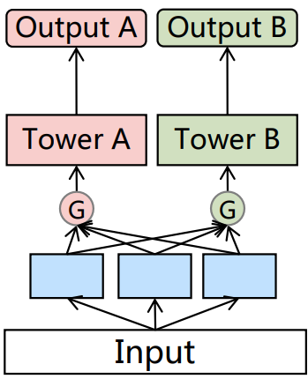
Related word / Prior method
1. Summary
Make effort to address only the negative transfer
But neglect the seesaw Phenomenon
<MMOE model>
Ex)- MMOE
Apply gate networks to handle task difference of bottom expert
Better capture task differences and optimize multiple objectives
- But MMOE can’t capture task correlation, which limit the performance of joint optimization
It is critical to design powerful Network that consider differentiation and interactions between experts

Slide 6
Related word / Prior method
1. Summary
There are some work to apply Task-specific / Task commom notion and to find good network structure
1) MTAN
2) SNR framework
First apply task-specific attention network to fuse shared features selectively
Tasks still share same representation before fusion in attention network
→ Apply Task-specific / Task-common notion
Control connections between sub-networks by binary random variables
Apply NAS to search for the optimal structure
→ But prior study of network structures are not general enough
Apply attention to utilize Task-specific / Task-common notion and Build more general network structure

Slide 7
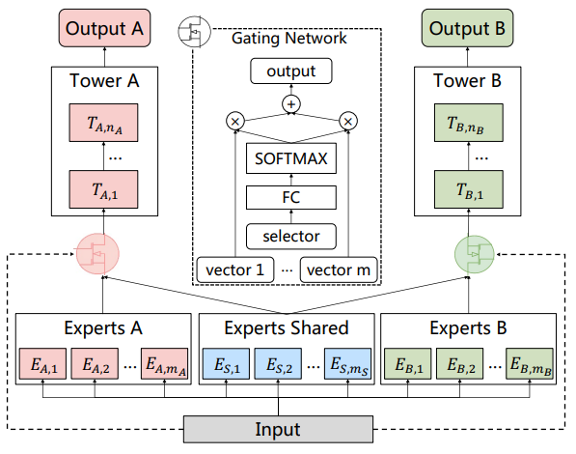
Solving Method – CGC
1. Summary
<Customized Gate Control>
<Customized Gate Control(CGC) Model>
Tower : Absorb knowledge from shared and specific expert through gate
Gate : Fuse representation of specific experts and shared experts dynamically
Bottom : Shared & Specific export modules
CGC achieves more flexible balance between tasks and better deals with task conflicts and sample-dependent correlation
Notes:
CGC 모델을 통해

Slide 8
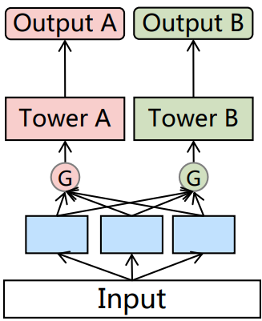
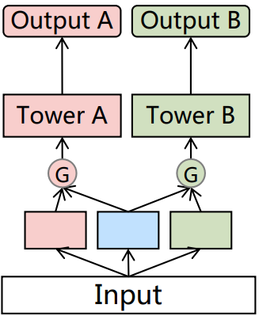
Solving Method – CGC
1. Summary
<MMOE vs CGC>
<MMOE Model>
<CGC Model>
There are two differences
Routing
MMOE connect all of experts
CGC connect each specific expert and shared expert
2. Bottom ingredient
MMOE only use task-specific expert
CGC use task-shared / task-specific experts
Specific expert 1
Specific expert 2
Specific expert 3
Specific expert 1
Shared expert
Specific expert 2
It looks like MMOE is generalization version of CGC.
But truth is not. It’ll be proved later
Notes:
Define problem (1장)
Problem of MTL
performance degeneration / Sacrifice each other
Negative transfer
Common phenomenon in MTL expecially for loosely correlated tasks
"seesaw Phenomenon"
where improving shared learning efficiency and achieving significant improvement over corresponding single-task model accross all task is difficult for current MTL models
VCR 과 VTR 관계 설명하기. the correlation pattern btw VCR and VTR is complex. - Seesaw phenomenon exist
Figure을 통해서 Seesaw Phenomenon 현상 제시하기.
We can observe the seesaw phenomenon

Slide 9
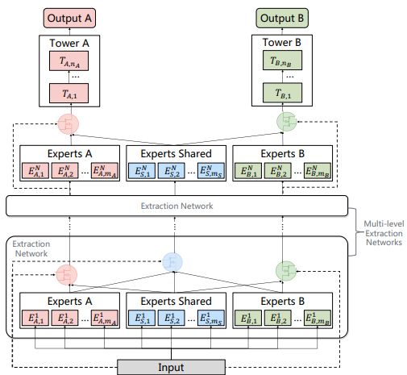
Solving Method – PLE
1. Summary
<Progressive Layered Extraction Model>
<PLE>
Hierarchy structure of information
Extract higher-level shared information
- Gating network in higher-level take the fusion results of gates in lower-level
2. Progressive separation routing
Remove connection with other task-specific
Consider higher-level shard semantic representation gradually
PLE shape out deeper semantic representations gradually with dividing whether the intermediate representations is shared or task-specific
Notes:
Define problem (1장)
Problem of MTL
performance degeneration / Sacrifice each other
Negative transfer
Common phenomenon in MTL expecially for loosely correlated tasks
"seesaw Phenomenon"
where improving shared learning efficiency and achieving significant improvement over corresponding single-task model accross all task is difficult for current MTL models
VCR 과 VTR 관계 설명하기. the correlation pattern btw VCR and VTR is complex. - Seesaw phenomenon exist
Figure을 통해서 Seesaw Phenomenon 현상 제시하기.
We can observe the seesaw phenomenon

Slide 10
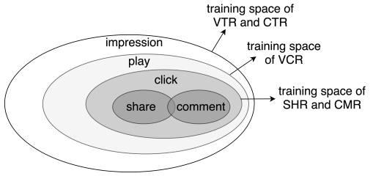
Solving Method – Joint Loss optimization
1. Summary
<Joint Loss Optimization for MTL>
Joint Representation
- Solve problem of heterogeneous samples space
ex) Due to sequential users action, share & comment
action are considered as heterogeneous
- Consider the union of sample space to train jointly
2. Introducing dynamic weight
Performance of MTL is sensitive to weight
Consider of weight tasks fluctuated with time
<Training Space of Different tasks>
By applying Joint Representation and dynamic weight, solve several issue in making joint optimization of MTL in practice
Notes:
Define problem (1장)
Problem of MTL
performance degeneration / Sacrifice each other
Negative transfer
Common phenomenon in MTL expecially for loosely correlated tasks
"seesaw Phenomenon"
where improving shared learning efficiency and achieving significant improvement over corresponding single-task model accross all task is difficult for current MTL models
VCR 과 VTR 관계 설명하기. the correlation pattern btw VCR and VTR is complex. - Seesaw phenomenon exist
Figure을 통해서 Seesaw Phenomenon 현상 제시하기.
We can observe the seesaw phenomenon

Slide 11
Experiment
1. Summary
Data
Industrial dataset from Tancent. 46,926 mil users / 2,682 mil video, 0.996 bil samples in Dataset
Public Dataset : Synthetic Data, Census-income Dataset, Ali-CCP Dataset
BaseLine model
Single model : Normal, Symmetric, Customized sharing, Cross-stitch, Sluice Network, MMOE
Multitask model : ML-MMOE
Test Case
1) Degree of Correlation between Variables(Strong or Loose)
2) Single-task model on Online A/B test
3) Single / Multi tasks
4) Expert Uilization Analysis between MMOE & PLE
Estimation
Calculate AUC & MSE of each Indicator(main on VCR, VRT) + MTL Gain
* MTL Gain : Quatitively evaluate the benefit of Multi-task learning over the single-task model
Notes:
Define problem (1장)
Problem of MTL
performance degeneration / Sacrifice each other
Negative transfer
Common phenomenon in MTL expecially for loosely correlated tasks
"seesaw Phenomenon"
where improving shared learning efficiency and achieving significant improvement over corresponding single-task model accross all task is difficult for current MTL models
VCR 과 VTR 관계 설명하기. the correlation pattern btw VCR and VTR is complex. - Seesaw phenomenon exist
Figure을 통해서 Seesaw Phenomenon 현상 제시하기.
We can observe the seesaw phenomenon

Slide 12
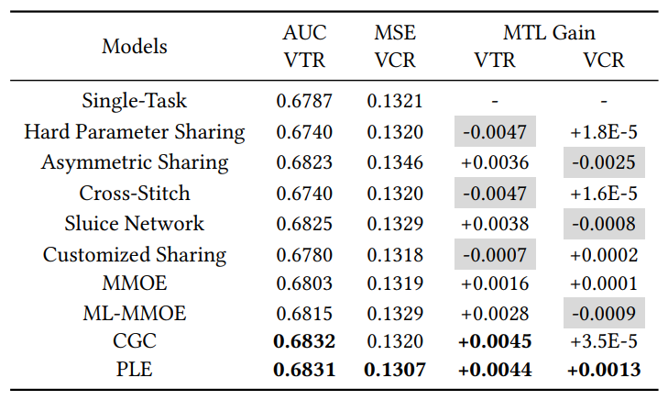
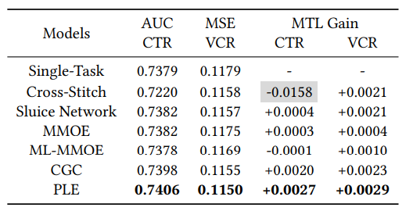
Result
1. Summary
<Strong Correlation between Variable>
<Loose Correlation between Variable>
identify seesaw phenomenon exist
PLE’s performance is really close to SOTA-method or over-performance
Even correlation between variables is loose, PLE overscore SOTA-MTL method
Regardless relation between variable is strong or loose,
PLE overscore for most aspect of test then SOTA-MTL method
Notes:
Define problem (1장)
Problem of MTL
performance degeneration / Sacrifice each other
Negative transfer
Common phenomenon in MTL expecially for loosely correlated tasks
"seesaw Phenomenon"
where improving shared learning efficiency and achieving significant improvement over corresponding single-task model accross all task is difficult for current MTL models
VCR 과 VTR 관계 설명하기. the correlation pattern btw VCR and VTR is complex. - Seesaw phenomenon exist
Figure을 통해서 Seesaw Phenomenon 현상 제시하기.
We can observe the seesaw phenomenon

Slide 13
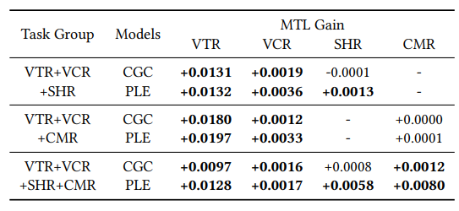
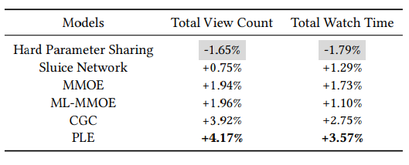
Result
1. Summary
<Performance on Online A/B test>
<MTL gain of CGC & PLE on Multi Tasks>
Shows improvement of MTL models over the single-task model on
Online total view count & watch time
CGC & PLE demonstrate the benefits of promoting task cooperation
PLE outperforms CGC in all cases
PLE delivers the best performance in real-world online applications
And it also proved the positive influence of Multi-task.
Notes:
Define problem (1장)
Problem of MTL
performance degeneration / Sacrifice each other
Negative transfer
Common phenomenon in MTL expecially for loosely correlated tasks
"seesaw Phenomenon"
where improving shared learning efficiency and achieving significant improvement over corresponding single-task model accross all task is difficult for current MTL models
VCR 과 VTR 관계 설명하기. the correlation pattern btw VCR and VTR is complex. - Seesaw phenomenon exist
Figure을 통해서 Seesaw Phenomenon 현상 제시하기.
We can observe the seesaw phenomenon

Slide 14
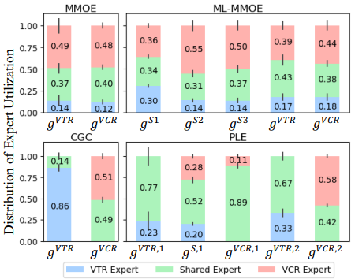
Result
1. Summary
MMOE is not Generalization of CGC
Distribution between MMOE & ML-MMOE is similar
But distribution of CGC& PLE is significantly different.
→ CGC’s structure helps achieve better differentiation & MMOE hard to converge CGC without prior knowledge
Higher-level deeper representation is Valuable
PLE performs better than CGC
Shared expert in PLE have larger influence
→ Certain deeper semantic representations are shared. And Progressive separation routing provides a better joint routing and learning scheme
<Expert Utilization in Gate-Based Models>
Expert Utilization show that PLE is good model than ML-MMOE & Higher-level deeper representation is Valuable in MTL
Notes:
Define problem (1장)
Problem of MTL
performance degeneration / Sacrifice each other
Negative transfer
Common phenomenon in MTL expecially for loosely correlated tasks
"seesaw Phenomenon"
where improving shared learning efficiency and achieving significant improvement over corresponding single-task model accross all task is difficult for current MTL models
VCR 과 VTR 관계 설명하기. the correlation pattern btw VCR and VTR is complex. - Seesaw phenomenon exist
Figure을 통해서 Seesaw Phenomenon 현상 제시하기.
We can observe the seesaw phenomenon

Slide 15
2. Pros & Cons
Based on 5 criteria

Slide 16
Criteria
2. Pros & Cons
Novel Idea
Good Motivation
Easy to read
Reproducible
Convincing Results
Notes:
Define problem (1장)
Problem of MTL
performance degeneration / Sacrifice each other
Negative transfer
Common phenomenon in MTL expecially for loosely correlated tasks
"seesaw Phenomenon"
where improving shared learning efficiency and achieving significant improvement over corresponding single-task model accross all task is difficult for current MTL models
VCR 과 VTR 관계 설명하기. the correlation pattern btw VCR and VTR is complex. - Seesaw phenomenon exist
Figure을 통해서 Seesaw Phenomenon 현상 제시하기.
We can observe the seesaw phenomenon

Slide 17
3. Research Idea

Slide 18
제목을 입력하세요
제목을 입력하세요
본문을 입력하세요 본문을 입력하세요 본문을 입력하세요 본문을 입력하세요 본문을 입력하세요 본문을 입력하세요 본문을 입력하세요 본문을 입력하세요 본문을 입력하세요

Slide 19
제목을 입력하세요
세계보건기구(WHO)의 팬데믹 선언 이후, 일상에서 익숙하게 했던 생활과 규칙은 깨어지고, 불편하고 예외적인 상황이 어느덧 우리 삶의 규칙이 되어가고 있다. 언제 끝날지 모르는 코로나 상황에서 미래에 대한 의혹과 익숙한 세계가 붕괴할 것만 같은 불안만이 가득하다.

Slide 20

제목을 입력하세요
제목을 입력하세요
본문을 입력하세요 본문을 입력하세요 본문을 입력하세요 본문을 입력하세요 본문을 입력하세요 본문을 입력하세요 본문을 입력하세요 본문을 입력하세요 본문을 입력하세요
[그림 1] 텍스트를 입력하세요

Slide 21
제목을 입력하세요
매출 전략의 3가지
제목을 입력하세요
수요
마케팅
본문을 입력하세요 본문을 입력하세요 본문을 입력하세요 본문을 입력하세요 본문을 입력하세요 본문을 입력하세요 본문을 입력하세요 본문을 입력하세요 본문을 입력하세요
공급

Slide 22
제목을 입력하세요
그래프 제목을 입력하세요
제목을 입력하세요
권역 | 1순위 | 2순위
미국 | 텍스트를 입력하세요 | 텍스트를 입력하세요
중국 | 텍스트를 입력하세요 | 텍스트를 입력하세요
일본 | 텍스트를 입력하세요 | 텍스트를 입력하세요
유럽 | 텍스트를 입력하세요 | 텍스트를 입력하세요
대한민국 | 텍스트를 입력하세요 | 텍스트를 입력하세요
본문을 입력하세요 본문을 입력하세요 본문을 입력하세요 본문을 입력하세요 본문을 입력하세요 본문을 입력하세요 본문을 입력하세요 본문을 입력하세요 본문을 입력하세요

Slide 23
제목을 입력하세요
제목을 입력하세요
제목을 입력하세요
본문을 입력하세요 본문을 입력하세요 본문을 입력하세요 본문을 입력하세요
본문을 입력하세요 본문을 입력하세요 본문을 입력하세요 본문을 입력하세요
본문을 입력하세요 본문을 입력하세요 본문을 입력하세요
본문을 입력하세요 본문을 입력하세요 본문을 입력하세요
본문을 입력하세요 본문을 입력하세요 본문을 입력하세요 본문을 입력하세요
본문을 입력하세요 본문을 입력하세요 본문을 입력하세요 본문을 입력하세요
본문을 입력하세요 본문을 입력하세요 본문을 입력하세요
본문을 입력하세요 본문을 입력하세요 본문을 입력하세요

Slide 24
제목을 입력하세요
그래프 제목을 입력하세요
제목을 입력하세요
SNS 유입의 확대
트렌드를 주도하는 플랫폼의 변화
마케팅 글쓰기의 중요성
브랜드화를 위한 필수작업
모름/무응답
9.3
필요하지
않다
필요하다
26.8(%)
63.9(%)
[그래프 2] 마케팅 플랫폼 분포도 조사

Slide 25
제목을 입력하세요
그래프 제목을 입력하세요
제목을 입력하세요
(단위: 시간)
SNS 유입의 확대
트렌드를 주도하는 플랫폼의 변화
마케팅 글쓰기의 중요성
브랜드화를 위한 필수작업
1,952
2,052
2016
2020
[그래프 1] 마케팅 글쓰기 분석조사

Slide 26
제목을 입력하세요
TextText
TextText
TextText
SNS 유입의 확대
트렌드를 주도하는 플랫폼의 변화
마케팅 글쓰기의 중요성
브랜드화를 위한 필수작업
SNS 유입의 확대
트렌드를 주도하는 플랫폼의 변화
마케팅 글쓰기의 중요성
브랜드화를 위한 필수작업
SNS 유입의 확대
트렌드를 주도하는 플랫폼의 변화
마케팅 글쓰기의 중요성
브랜드화를 위한 필수작업

Slide 27
제목을 입력하세요
제목을 입력하세요
제목을 입력하세요
본문을 입력하세요. 본문을 입력하세요
Text
본문을 입력하세요. 본문을 입력하세요
Text
제목을 입력하세요
제목을 입력하세요
Text
Text
본문을 입력하세요. 본문을 입력하세요
본문을 입력하세요. 본문을 입력하세요

Slide 28
SWOT 다이어그램
S 강점
W 약점
본문을 입력하세요. 본문을 입력하세요
S
W
본문을 입력하세요. 본문을 입력하세요
O
T
O 기회
T 위협
본문을 입력하세요. 본문을 입력하세요
본문을 입력하세요. 본문을 입력하세요

Slide 29

감사합니다
한국대학교 경영학과 2학년
2019012374
홍 수 현

Slide 30


소스
FONT
COLOR
작은 글자: KoPubWorld돋움체 Light 14pt
본문: KoPubWorld돋움체 Medium 18pt
제목: KoPubWorld돋움체 Bold 24pt
FONT COLOR
제목: KoPubWorld돋움체 Bold 32pt
DIAGRAM
DOWNLOAD :KoPubWorld돋움체
제목을 입력하세요
제목을 입력하세요

Slide 31
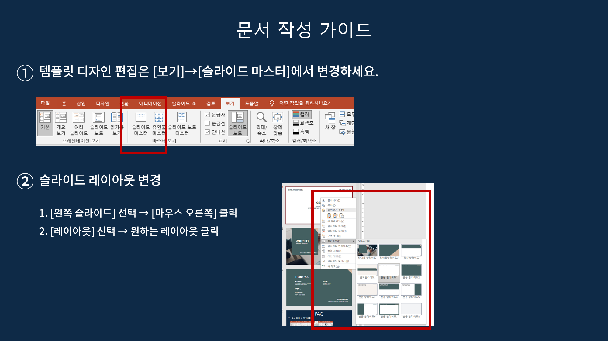

Slide 32
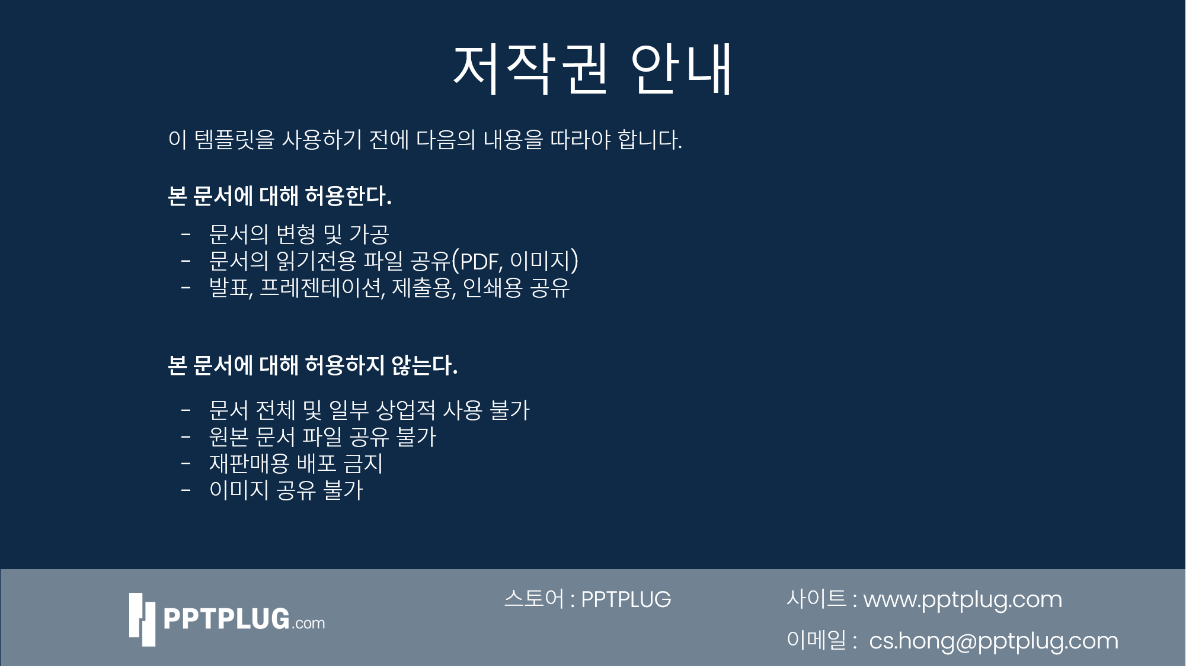

Slide 33


